Slide 1
DRIVERLESS CARS
Name: Gilberto Caobianco Junior
Student Number: 16108647

Slide 2
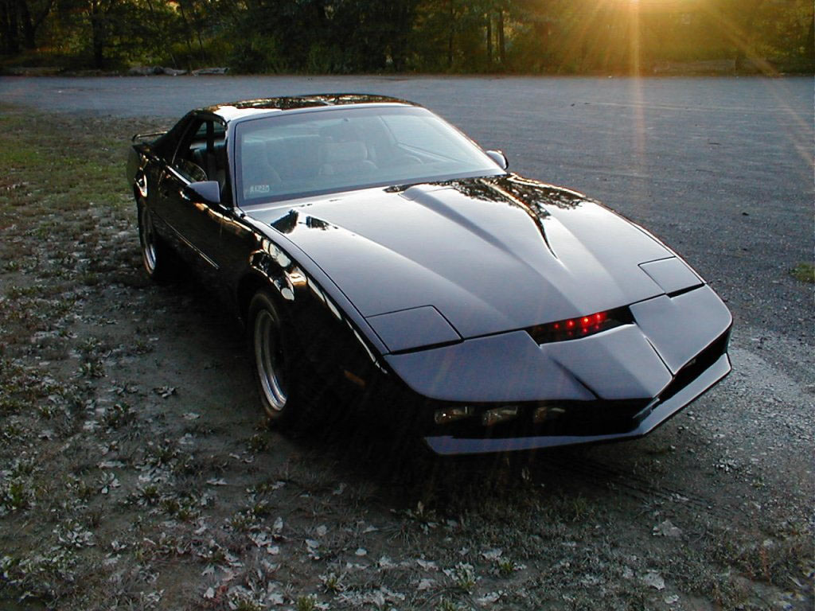
Autonomous Vehicles Defined
Are you ready to be driven, not by your chauffeur, but your car itself?
These cars are now been tested out on the roads

Slide 3
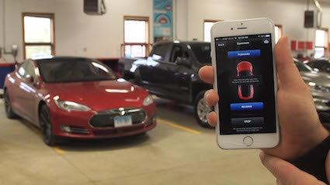
Semi-Autonomous
Where the technology is today.
Tesla’s Summon Feature.
Have your car pick you up at the door.

Slide 4
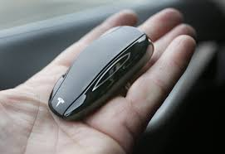
Semi-Autonomous
Where the technology is today.
You can summon your car with the Key fob or with the smartphone app.

Slide 5
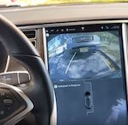
Semi-Autonomous
Where the technology is today.
Self-parking feature
Tesla Model S can parallel park itself.

Slide 6
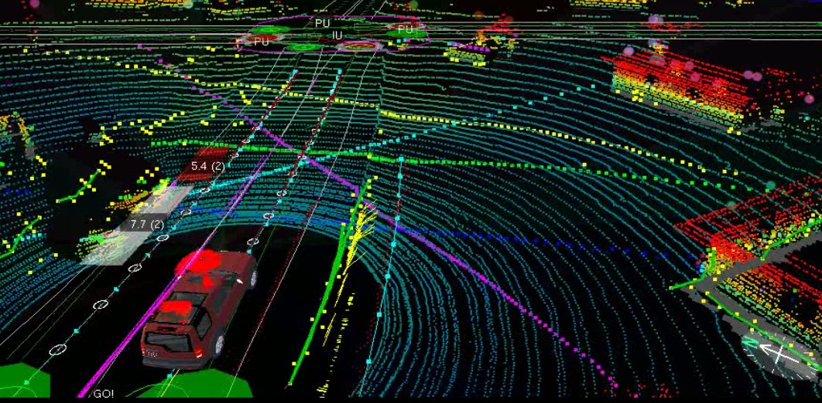
The Technology of the Car
1-The heart of the car is the rotating roof top camera,
2-This camera creates 3D images of objects helping the car see hazards along the way.
3- It calculates how far an object is fro the moving vehicle based on the time it takes for the lase beams to hit the object and comeback.
4-These lasers can calculate and create images for objects in an impressive 200m range.

Slide 7
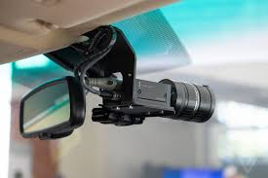
Windshield Camera
Features:
Camera mounted on the windshield takes care of helping the car “see”
These incluse the usual suspects-pedestrians and other motorists.
The camera also detects and records information about road signs and traffic lights

Slide 8
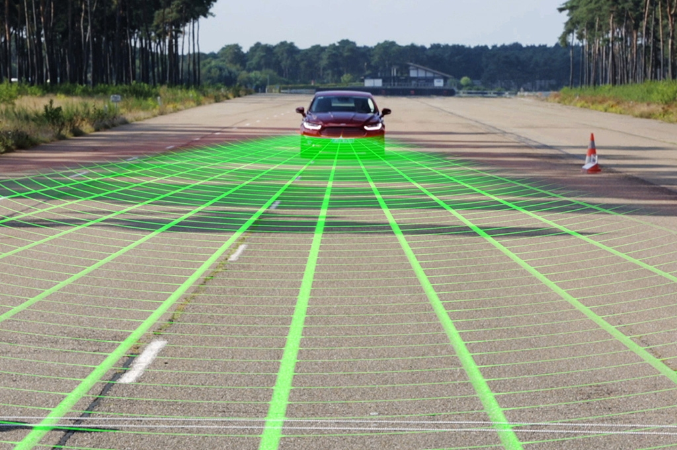
Bumped Mounted Radar
Features:
4 radars mounted on the car’s front and rear. Enable the car to be aware of vehicles in front and behind it.
Keeps a digital eye on the car ahead and behind
Software is programmed to maintain distance of 2-4 secs all the time(can be higher).
This technology the car will speed up or slow down depending on the behaviour of the car/driver ahead

Slide 9
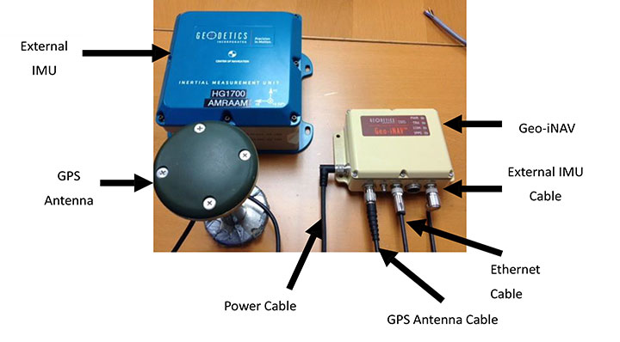
Aerial that reads precise Geo-Location
GPS inertial navigation help the car to localize itself.
GPS data is compared with sensor map data, collected from the same location.
As the vehicle moves, the internal map is updated

Slide 10
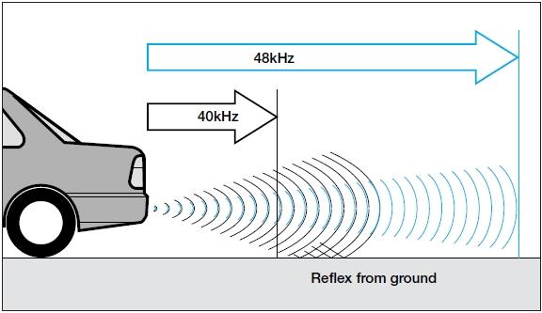
Ultrasonic Sensor on rear wheels
Keep the track of the movements of the car
Alerts the car about obstacles in the rear
Blind spot monitoring
Warn if cars are in blind spots
Technology help to navigate the car into tight reverse parking spots
Sensors get activated when the car is engaged in the reverse gear

Slide 11
Devices within the car
Altimeters
Gyroscopes
Tachnymeters
This offers accurate data for the car to operate safely.

Slide 12
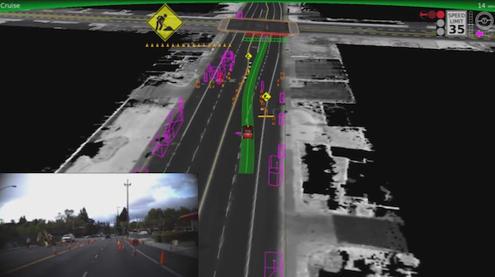
Programmed to Interpret Common Road Signs
Software programmed to interpret common road behaviour and motorists signs
Predetermined shape and motion descriptors are programmed into the system.
The car can detects a 2 wheel object and determine the speed of it.
Several such programs fed into the car’s central processing unit will work simultaneously.
The car can make self intelligent decisions on busy roads.

Slide 13
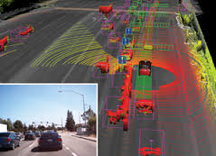
Mapping in Advance
The map is fed into the car’s software helping the car to identify regular parts of the road.
The car can detects a 2 wheel object and determine the speed of it.
As the car moves, its Velodyne laser range generates a detailed 3D map of the enviroment around the car.
The car compares this map with the pre-existing map to figure out the non standard aspects in the road.

Slide 14
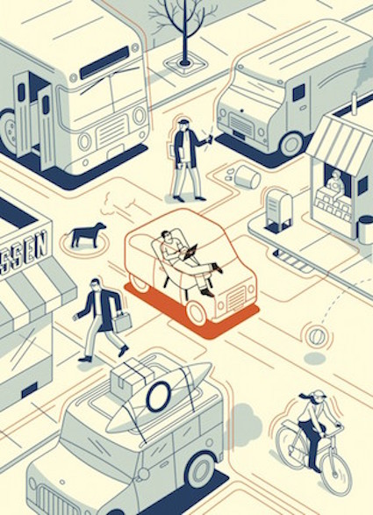
Programming Real Life Road Behaviour
Vehicle slow down to allow other motorists to go ahead.
The car is programmed to advance ahead if it detects that other vehicle is not moving.

Slide 15
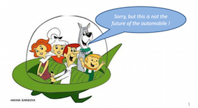
Perceived Future
Todays new tech will be an old hat by 2021. In car connectivity!
In 2021 we should expect the first mass production of self-driving cars to be on according to Elon Musk.
Ford say Networking will allow cars to sense each other.
After further experimenting with LiDar the car should be able to see the world around in real time.

Slide 16
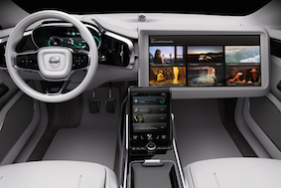
Perceived Future
Volvo has heavily been exploring self-driving technology see right for Concept 26 design
At some point we will implement these ideas: Compute indendently communicating through the cloud
Lets face it there will still be those people.

Slide 17


Downside to driverless cars
How much it will cost?
Loss of jobs
Insurance responsibilties

Slide 18

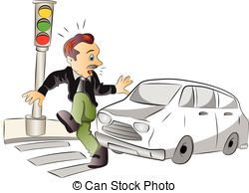
Upsides to driverless cars
Accessibility
Road Safety
Cheaper Insurance

